Slide 1
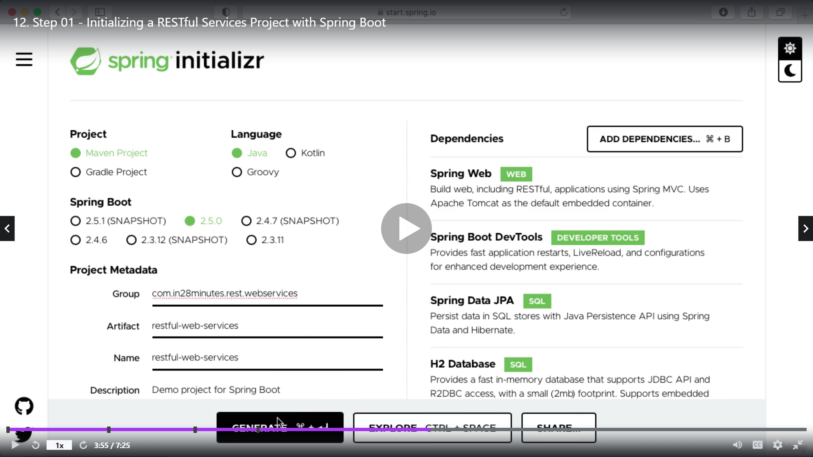
Go to Spring boot website and generate a project by adding these dependencies. H2 is inbuilt data base and jpa is used to connect to db.
Import this project in eclipse

